Slide 1
Term Project Presentation
Sentiment Analysis
DSCI511 Spring 2022
Kelsey Muckelbauer
Michael Fenton
Will Wu
Ishtiaq Shahriar

Slide 2



Project Summary
We will be attempting to do a sentiment analysis by using Amazon reviews of various versions of the Nintendo Switch. We will collect data by calling API for Amazon. We will process and analyze this data by parsing, bucketing, and counting each word in the review. We will then use this data to build a Naive Bayes model to predict positive, negative, or neutral sentiments for other products with text-based reviews.
For our project, the data that will “teach” our code which will come from the reviews of the “Green and Blue” and “Gray” versions of the Nintendo Switch.
We will then run our code on the “Neon Blue and Red” version of the Nintendo Switch to predict the sentiments of the reviews.
Notes:
Kelsey and Will

Slide 3
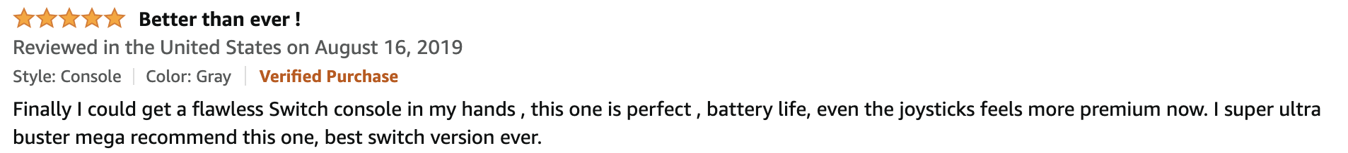
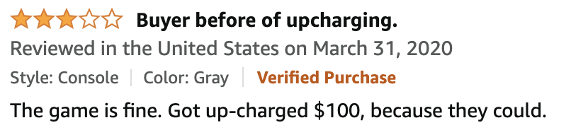
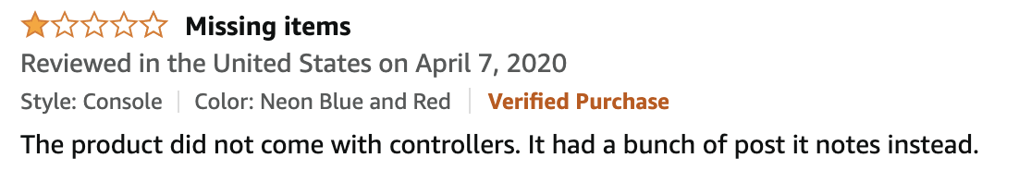
Source of the Data
For this project we got our data from text reviews of the Nintendo Switch on Amazon.
Good Review:
Neutral Review:
Bad Review:
Notes:
Kelsey and Will

Slide 4
How the Code Works
Notes:
Mike
Now we are going to delve into how our code works.

Slide 5

Getting the Data
API services
Amazon API
RapidAPI
Fetching Data (if downloaded data already doesn’t exist)
For each product variant
Download reviews page-by-page
Product review page contains up to ten reviews
Requests stop when any of these happen:
Reach soft cap set in code configuration
Requests return zero reviews
Reach hard cap of max known pages per product
Notes:
Mike
We looked at two options for accessing Amazon review data. Our first choice was to use Amazon’s own API solution but we ran into issues getting AWS approval for API access. We, instead, opted to use RapidAPI which, though it is a paid subscription service, worked well and had all the features we needed.
For each of the three variants of Nintendo Switch for sale on Amazon, we first check to see if the downloaded dataset already exists on file. If not, we make a request to fetch reviews one page at a time. Each page contains up to ten reviews and is returned in JSON format. Each review on the page contains review specific data, such as: star rating, review, reviewed product id, and so on. We continue to request pages one at a time until one of three things happen: we reach our configurable softcap for number of requests, we start to receive empty review sets (which signifies there are no more reviews available for that product), or we reach the hard cap number for maximum pages which reflects the previously determined max number of reviews per product.

Slide 6
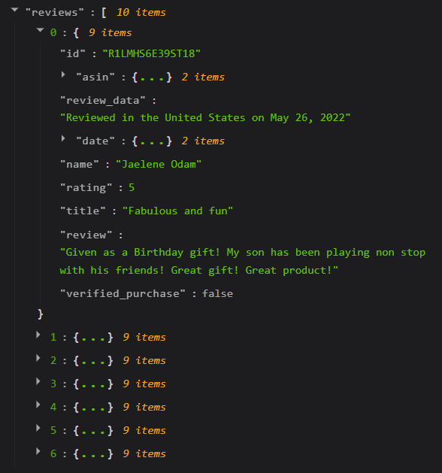
Getting the Data
Returned Data
Temporarily stored in list
Saved to disk as JSON
One JSON per product
Notes:
Mike
As each review page is returned, we add each individual review to a list of previous reviews for that product.
When we reach the end of our request loop, since we want to conserve the number of requests we make, we save the list into a JSON file to disk.
Each product’s review set is stored in it’s own file so that product reviews can be investigated individually and re-fetching a product’s full review set doesn’t require us to re-fetch them all.

Slide 7
Data Dictionary
ID: Amazon ID of customer leaving the review
ASIN: (Amazon Standard Identification Number) unique ID for each product or product version listed on Amazon.
ASIN-ORIGINAL: ASIN of the product that current review is originally for.
ASIN-VARIANT: ASIN of other product variants that current review wasn't written for but could be applied to
REVIEW_DATA: Location and date of review
DATE-DATE: Date of review
DATE-UNIX: Date of review using UNIX date scheme
NAME: Name of the reviewer
RATING: Star rating, from 1 (lowest) to 5 (highest), of the product given by the reviewer
TITLE: Title of the review provided by the reviewer
REVIEW: Written review text from the reviewer for this product.
VERIFIED_PURCHASE: Whether or not the reviewer has purchased product (per Amazon).
Notes:
Mike
The fields that are returned by the API for each Amazon review consist of the information here..
Even though we only use a handful of fields, we still store the full dataset for any future needs.
The fields relevant to us, for this process are:
ASIN (the unique ID given to each Amazon product) by which we request and store reviews.
Rating: Which is the 1-5 star rating that the reviewer gave to the product.
Title: The title of the review given by the reviewer
And the review field which contains the reviewer’s text.

Slide 8
Parsing the Data
Our code reads each review and looks at each word individually. To make our code effective, we need to clean up the reviews:
Removed the 100 most common English words (source: Wikipedia) as well as other common stop words
These words hold no value for our purposes.
Removed non-alpha characters
Removes all punctuation, numbers and other random characters.
Made all the letters lowercase
This way there is no difference between “Good” and “good” and those words can be counted as the same.
Example of Parsing a Review:
“Such a great product! Great packaging and such a fun time. I 100% recommend this product.”
[ “such” : 2, “great” : 2, “product” : 2, “packaging” : 1, “fun” : 1, “time” : 1, “recommend” : 1 ]
Notes:
Kelsey and Will
Once we received the data from the API, we then parsed our data. Our code reads each review and looks at each word individually. But, to make our code effective, we need to clean up the reviews.
First we removed the 100 most common English words as well a some other common words that we saw within the reviews. Some examples of these words are “I”, “is”, “that”, and “the”. These words held no value for our purposes so we removed them so that they wouldn’t be taken into account throughout the rest of our code.
Next, we removed all the non-alpha characters. This means that we would remove all punctuation, numbers and any other random characters. We wanted to do this because they are again, irrelevant for our code and also removing them allows there to be no difference between someone saying “awesome.” and “awesome!” because they will both be just awesome with no punctuation and the words can be counted the same.
Lastly, we made all of the letters lowercase.This way, there is no difference between “Good” with a capital G and “good” with a lowercase g and the words would be counted the same.
An example of the data parsing is shown at the bottom of the slide, so the sentence “Such a great product! Great packaging and such a fun time. I 100% recommend this product.” Because of the cleaning up that we did in our code, “Such” with a capital “S” and “such” with a lowercase “s” are counted as the same and, “product!” and “product.” are counted the same. Also “100%” is not included.

Slide 9

Parsing the Data
The number of words in each type of review are then tallied and added to “good”, “neutral” and “bad” buckets:
Words from 1 and 2 star reviews are added to the “bad” bucket
Words from 3 star reviews are added to the “neutral” bucket
Words from 4 and 5 star reviews are added to the “good” bucket
Notes:
Kelsey and Will
Then, based on the star value of the review, the words are tallied up into bad, neutral, and good buckets. Reviews with 1 and 2 star ratings are considered bad reviews, reviews with 3 star ratings are considered neutral, and reviews with 4 and 5 star reviews are considered good.
Then, by the time we have parsed all the reviews, we will have a bucket of good words with a count for each word for how many times it is in each good review as well as the same for neutral and bad reviews.

Slide 10
Multinomial Naive Bayes Classifier
Calculate P(c_{j}) (prior) terms
For each c_{j} in C do
docs_{j} ← all docs with class = c_{j}
P(c_{j}) ← |docs_{j}| / | total # documents|
From training corpus, extract Vocabulary
Calculate P(w_{k}|c_{j}) (likelihood) terms
Text_{j} ← single doc containing all docs
For each word w_{k} in Vocabulary
n_{k} ← # of occurrences of w_{k} in Text_{j}
P(w_{k}|c_{j}) ← (n_{k} + 𝞪) / |n + 𝞪|Vocabulary|
Notes:
Ishtiaq

Slide 11
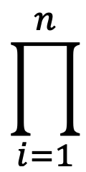
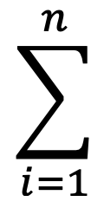
Multinomial Naive Bayes Classifier (continued)
Calculate P(c_{j} |w_{k}) (posterior) terms
P(c_{j} |w_{k}) ∝ P(c_{j} ) P(w_{k}|c_{j})
For numerical stability
logP(c_{j} |w_{k}) ∝ logP(c_{j} )+ log P(w_{k}|c_{j})
logP(c_{j} |w_{k}) ∝ logP(c_{j} )+ log P(w_{k}|c_{j})

Slide 12
Multinomial Naive Bayes Classifier (Example)
Dataset:
 | Docs | Words | Class
Training | 1 | I love this product | positive
 | 2 | Amazing! this product is one of the best, love it | positive
 | 3 | Amazing device, would recommend to anyone, best in class | positive
 | 4 | Horrible device, waste of money | negative
Test | 5 | Total waste of money, horrible experience | ?

Slide 13
Multinomial Naive Bayes Classifier (Example)
Step 1:
Calculate positive prior:
total positive docs/ total docs
Calculate negative prior:
total negative docs/ total docs
Step 2:
Calculate likelihood for the test words being positive:
Total = 0+1/(23+19)
Waste = 0+1/(23+19)
Of = 1+1/(23+19)
Money = 0+1/(23+19)
Horrible = 0+1/(23+19)
Experience = 0+1/(23+19)
Calculate likelihood for the test words being negative:
Total = 0+1/(5+19)
Waste = 1+1/(5+19)
Of = 1+1/(5+19)
Money = 1+1/(5+19)
Horrible = 1+1/(5+19)
Experience = 0+1/(5+19)
Step 3:
Predicting class for document 5:
P(positive|d5) = log(positive prior) + log(Total) + log(Waste) + log(of) + log(Money) + log(Horrible) + log(Experience)
P(negative|d5) = log(negative prior) + log(Total) + log(Waste) + log(of) + log(Money) + log(Horrible) + log(Experience)
Prediction = document 5 has a negative sentiment

Slide 14
Results

Slide 15
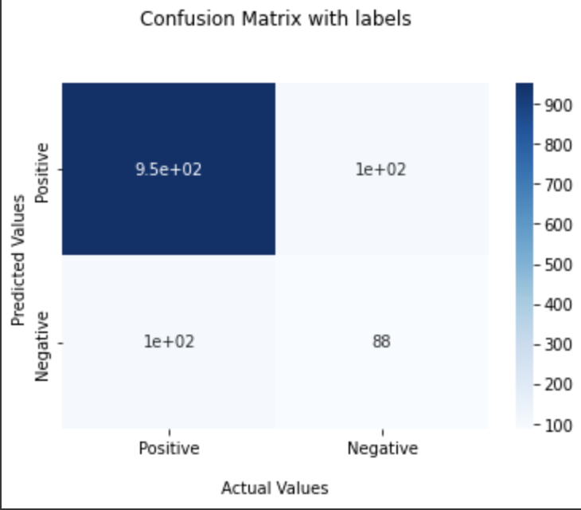
Binary Classification

Slide 16
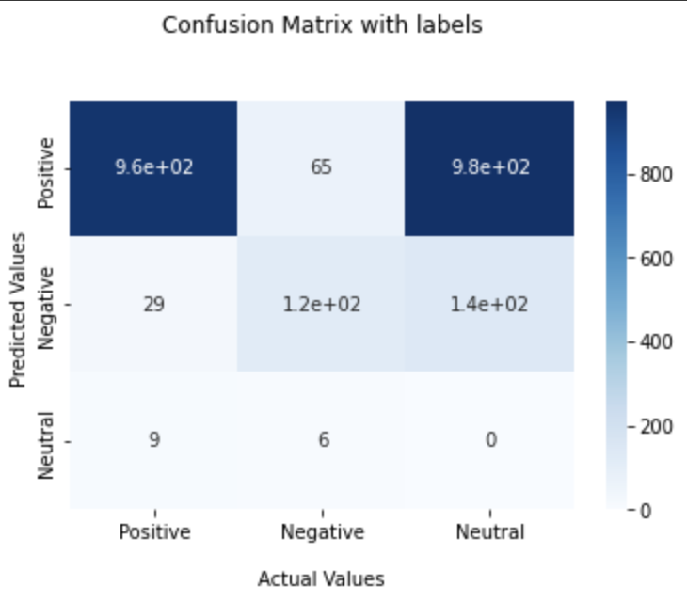
Multiclass Classification

Slide 17
Precision Recall F Measure and Accuracy
 | Precision | Recall | F-measure | Accuracy
Binary Classification | 0.90 | 0.96 | 0.93 | 0.88
MultiClass Classification | 0.47 | 0.48 | 0.46 | 0.64
Notes:
Ishtiaq

Slide 18
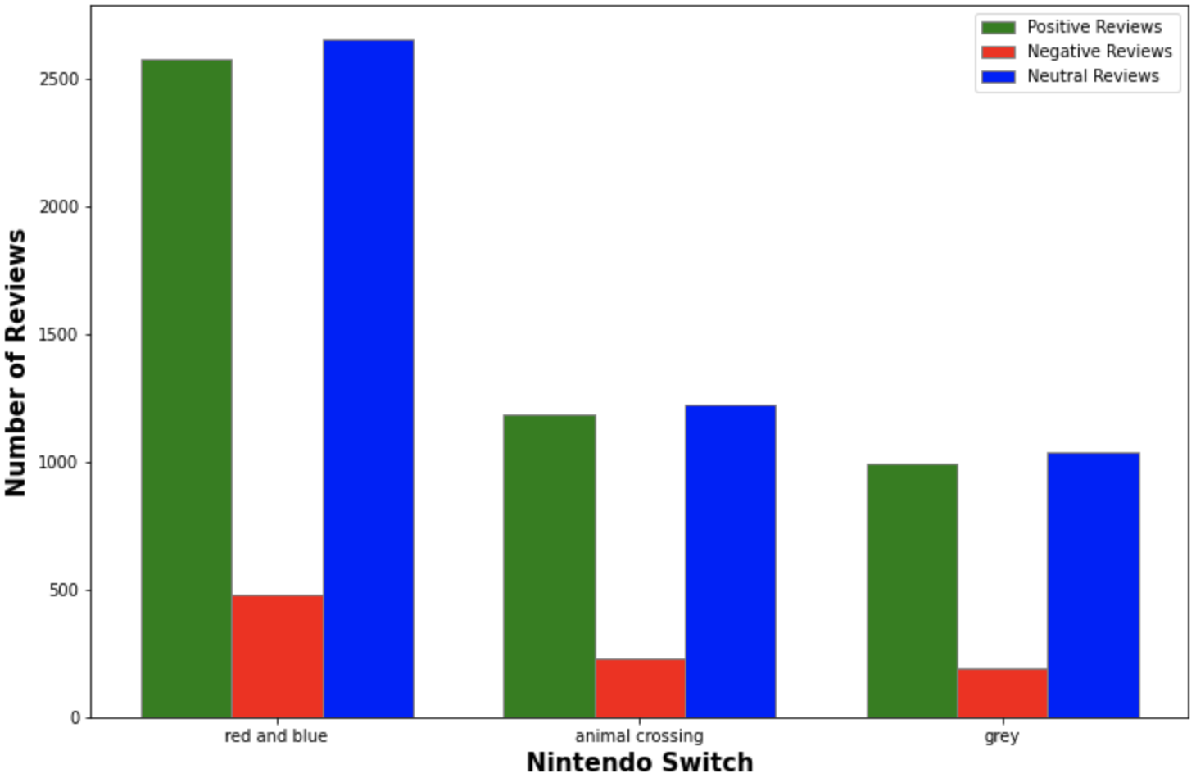
Review Count For Each Category of Products

Slide 19

Distribution Plan
Project available on GitHub:
https://github.com/MF80/DSCI511-TermProject
Full dataset provided
API key is provided in notebook accompanying presentation files.
API key is not provided on GitHub
Notes:
Michael and Kelsey and Will
Distribution and continued worked:
This project will be available on GitHub for any future work considered. The API key is provided in the submitted notebook but will be removed from the GitHub based source code. Those continuing this work will have to obtain an API key through RapidAPI.
Future work can include: larger/different data sets, work identifying words with the highest variance (those with the highest relative weights), analyzing the difference between reviews from verified purchasers and non-verified purchasers or reviews from different regions.

Slide 20
Workload Distribution
Kelsey Muckelbauer
Parsing the Data
Presentation Organization
Michael Fenton
API / Data collection
README.md
Will Wu
Project Overview
Ishtiaq Shahriar
Naive Bayes
Project Results
Notes:
All

